Slide 1








Amazon FSx: Overview
Amazon FSx provides managed file systems
AWS handles provisioning, patching, and maintenance
Provides familiar file-system interfaces
Supports Windows, Linux, HPC, and enterprise workloads
Integrates with other AWS services

Slide 2

Why Use Amazon FSx?
Avoid managing file-server infrastructure
Get scalable and managed storage
Choose a file system for the workload
Improve availability and operational efficiency
Use AWS security and monitoring capabilities

Slide 3








Amazon FSx Family
FSx for Windows
FSx for Lustre
FSx for NetApp ONTAP
FSx for OpenZFS
Designed for high-performance computing
Designed for Windows workloads
Designed for Linux and OpenZFS workloads
Designed for NetApp and enterprise workloads

Slide 4



FSx for Windows File Server
Managed Windows file storage
Uses the SMB file-sharing protocol
Supports Windows-based applications
Integrates with Microsoft Active Directory
Useful for shared folders and enterprise file services
Features: Distributed File System (DFS), Volume Shadow Copy Service (VSS), and NTFS permissions.

Slide 5




FSx for Lustre
High-performance managed file system
Designed for compute-intensive workloads
Common in HPC, AI, and ML workloads
Provides high throughput and low-latency access
Can work with Amazon S3 for data processing workflows

Slide 6



FSx for NetApp ONTAP
Managed NetApp ONTAP file system
Supports enterprise storage features (snapshots, cloning, compression, deduplication, and replication and thin provisioning)
Supports NFS and SMB access
Useful for migrating NetApp workloads to AWS
Supports advanced data management capabilities

Slide 7



FSx for OpenZFS
Managed OpenZFS file system
Designed mainly for Linux workloads
Supports NFS-based file access
Provides familiar OpenZFS capabilities (Snapshots, Cloning, Compression, and Efficient storage management)
Useful for applications needing high-performance file storage

Slide 8
Comparing the Four FSx Services
Service | Target Workload
Windows File Server | Windows and SMB workloads
Lustre | HPC, AI, and ML workloads
NetApp ONTAP | NetApp and enterprise workloads
OpenZFS | Linux and OpenZFS workloads
Selection should be based on application and file-system requirements

Slide 9




How to Select an FSx Service
Identify the operating system and application
Check required file protocols
Evaluate performance and throughput needs
Consider existing enterprise storage technology
Match the service to the workload:
Windows → Windows File Server
HPC/AI/ML → Lustre
NetApp → ONTAP
Linux/OpenZFS → OpenZFS

Slide 10








FSx Real-World Examples
Windows file shares
AI model training
NetApp migration
Linux NFS app
FSx for Windows File Server
FSx for Lustre
FSx for NetApp ONTAP
FSx for OpenZFS
The workload determines the appropriate file system

Slide 11



What Is Data Durability?
Durability is the ability to preserve data over time
High durability means data is unlikely to be lost
Replication and redundant storage can improve durability
Durability focuses on data survival
Example: replicated copies protect against disk failure

Slide 12


What Is Data Availability?
Availability is the ability to access data when needed
High availability minimizes service interruptions
Redundant components can keep storage accessible
Availability focuses on continued access
Example: a failover system can keep storage online after a failure

Slide 13


Durability vs Availability
Durability
Availability
Can the data survive?
Can the data be accessed?
Durable data can still be temporarily unavailable if the system is offline.
Highly available storage can still require backups for recovery from logical errors.

Slide 14

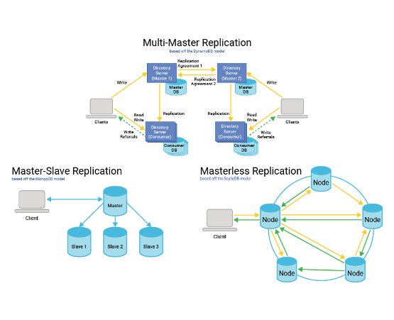




Replication
Replication creates additional copies of data
Copies can be placed on separate infrastructure
Replication can reduce the impact of component failure
Synchronous or asynchronous methods may be used
Replication is not the same as backup

Slide 15

Redundancy
Redundancy provides alternative components or paths
Storage may use redundant disks or nodes
Network and compute components can also be redundant
Failure of one component does not necessarily stop the service
Redundancy supports availability and resilience

Slide 16


How AWS Protects Data
Uses redundant infrastructure and managed services
Supports replication and backup mechanisms
Provides encryption and access controls
Offers monitoring and auditing services
Protection depends on the architecture and service configuration

Slide 17


Backup vs Durability
Durability & Replication
Backup
Durability protects against data loss during normal storage operation.
Backup creates recoverable historical copies.
Replication can copy current data, including unwanted changes (e.g., if a file is corrupted, the corruption is replicated).
Backups can help recover deleted or corrupted data by rolling back to a previous point in time.

Slide 18


Highly Available Storage Architecture
Application → Storage service → Redundant infrastructure
Redundant paths reduce single points of failure
Replication provides additional data protection
Monitoring detects failures and abnormal behavior
Backup enables recovery from logical or major failures

Slide 19


Monitoring Storage Reliability
Monitor capacity, performance, and failures
Track unusual changes in storage behavior
Use alarms for important metrics
Review logs and operational events
Monitoring helps detect problems before they become major incidents

Slide 20



Amazon CloudWatch
Provides monitoring and observability
Collects metrics and logs from AWS resources
Supports alarms and automated responses
Can help identify storage performance issues
Useful for operational visibility

Slide 21




AWS CloudTrail
Records AWS API activity
Helps identify who performed an action
Supports security auditing and investigation
Useful for tracking backup and storage configuration changes
Complements CloudWatch monitoring

Slide 22
Data Protection Example
Scenario: Application stores customer files in AWS
Redundant storage → improves resilience
Backup → provides recovery points
CloudWatch → monitors health and performance
CloudTrail → records administrative actions

Slide 23
Multi-AZ Design and Resilience
Amazon S3
Amazon EFS
Amazon EBS
Standard classes store objects redundantly across multiple AZs in a Region.
Standard file systems store data across multiple AZs; mount targets are created in each AZ.
A volume lives in one AZ and attaches only to instances in that AZ.
One AZ failing does not make data unavailable. One Zone classes use a single AZ.
Instances in other AZs keep access if one AZ fails. One Zone option uses a single AZ.
Protect it with snapshots, which can restore a volume in another AZ or Region.
Analysis: Durability = data survives; availability = data can be reached. Spreading data and instances across AZs removes the single point of failure, so one AZ outage reduces capacity but not service. A single-AZ resource (one EBS volume, One Zone class) loses both access and protection if that AZ fails.
Notes:
Q20. Added standard AWS knowledge: S3 Standard and EFS Standard store across multiple AZs; EBS volumes are AZ-scoped. Verify in AWS docs.

Slide 24




What Is AWS Backup?
AWS Backup is a centralized backup management service
Automates backup across supported AWS resources
Provides backup plans and policies
Centralizes backup monitoring and management
Supports recovery from accidental deletion and failures

Slide 25


Why Centralized Backup Is Needed
Different services can otherwise require separate backup processes
Centralization improves consistency
Policies can be applied across multiple resources
Reduces manual backup administration
Supports organization-wide protection strategies

Slide 26
How AWS Backup Works
Manage Retention
Assign Resources
Keep backups for required periods
Select resources to protect
Create Plan
Create Point
Define backup rules
Store backup data
Final Step: Restore → Recover resources when needed

Slide 27


Backup Plan
Defines when backups should run
Defines backup retention settings
Can contain multiple backup rules
Can include lifecycle policies
Provides repeatable backup operations

Slide 28


Backup Vault
Logical container for recovery points
Helps organize and control backups
Can use access policies and encryption
Different vaults can support different protection requirements
Acts as a managed location for backup recovery points

Slide 29


Recovery Point
A recovery point represents a backup copy
It can be used to restore protected data
Recovery points have creation and retention information
Multiple recovery points can provide historical recovery options
Example: daily backups provide multiple restore dates

Slide 30


Resource Assignment & Tag-Based Backup
Resource assignment identifies what should be backed up
Resources can be selected directly
Tags can group resources by application or environment
Tag-based selection reduces manual resource management
Example: Environment=Production → protect production resources

Slide 31

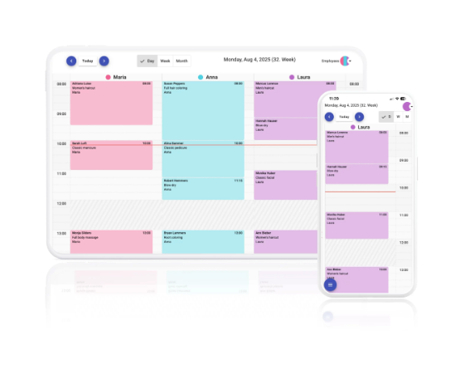


Backup Scheduling and Retention
Schedules define when backups are created
Retention defines how long recovery points are kept
Daily, weekly, or m onthly policies can be used
Longer retention supports compliance and historical recovery
Schedules should match business recovery requirements

Slide 32


Lifecycle Policies
Move backups to lower-cost storage when appropriate
Expire recovery points after the retention period
Automates backup storage management
Balances recovery needs and storage cost
Lifecycle settings should follow organizational policy

Slide 33

Backup Security
IAM controls who can perform backup operations
AWS KMS can provide encryption key management
Backup vault controls can restrict access
CloudTrail records relevant API activity
Security should protect both backup data and management actions

Slide 34



Cross-Region and Cross-Account Backups
Cross-Region backup copies protect against regional failures
Cross-account copies improve isolation from the source account
Additional copies reduce dependence on one location or account
Policies and permissions must allow the required operations
Use these capabilities as part of a broader recovery strategy

Slide 35

Restoration and AWS Backup Example
Select an appropriate recovery point
Choose the target restore configuration
Restore the protected resource
Validate application functionality after recovery
Example: restore a deleted production database from yesterday's recovery point

Slide 36
AWS Backup: EC2, EBS, EFS
Resource | What AWS Backup creates | Restore result
Amazon EC2 | Instance backup (image plus its EBS snapshots) | New instance
Amazon EBS | Volume snapshot recovery point | New volume
Amazon EFS | File-system backup recovery point | Full or partial restore of the file system
All three are supported resource types, so one plan can protect a mixed workload: recovery points from every service are stored in a backup vault, managed with the same schedule, retention and copy rules.
Notes:
Q22. RDS is named explicitly. Added standard AWS knowledge: recovery point types per service; verify supported features (e.g. continuous backup, partial restore) in AWS Backup docs.

Slide 37
Backup Design and Justification
1
One backup plan
Daily backup rule for all production resources; run in a defined backup window.
2
Tag-based assignment
Assign resources with a tag such as backup=prod, so new EC2, EBS, EFS resources join automatically.
3
Retention rules
Keep daily points about 35 days and monthly points longer; use cold storage where supported, then expire.
4
Cross-Region copy
Copy recovery points to a vault in a second Region (optionally another account) for Regional failure.
5
Restore validation
Test restores regularly; encrypt with KMS and restrict vault access with IAM.
Note: one plan with tags gives consistent protection and fewer missed resources; retention balances recovery needs against storage cost; the cross-Region copy lowers the risk of losing both data and backups in one Region (RPO is set by backup frequency, RTO by restore time);
Notes:
Q22 design: example values (daily, 35 days, monthly) are illustrative additions; adjust to RPO/RTO and compliance needs.

Slide 38
What Is Disaster Recovery?
Disaster Recovery (DR) is the process of restoring IT services after disruption
DR addresses major failures, outages, and disasters
The goal is to restore critical business operations
DR combines technology, processes, and procedures
A DR plan should be tested regularly

Slide 39



Why Disaster Recovery Is Important
Reduces business downtime
Limits data loss
Protects critical applications and services
Supports business continuity
Provides a planned response instead of an improvised response

Slide 40








Common Causes of Disasters
Hardware
Software
Human
Nature/Cyber
Hardware and infrastructure failures
Software errors and data corruption
Human mistakes and accidental deletion
Cybersecurity, power, network, regional, or natural disasters

Slide 41
Recovery Point Objective (RPO)
RPO defines the maximum acceptable amount of data loss
It is measured as a time interval
Example: RPO = 1 hour → up to 1 hour of data may need to be recreated
Lower RPO generally requires more frequent replication or backups

Slide 42

Recovery Time Objective (RTO)
RTO defines the target time to restore service
It measures acceptable recovery downtime
Example: RTO = 30 minutes → service should be restored within about 30 minutes
Lower RTO generally requires faster recovery infrastructure

Slide 43


RPO vs RTO
RPO
RTO
How much data can we afford to lose?
How long can the service be unavailable?
RPO focuses on data recovery point (the past).
RTO focuses on service recovery time (the future).
Both should be defined from business requirements

Slide 44

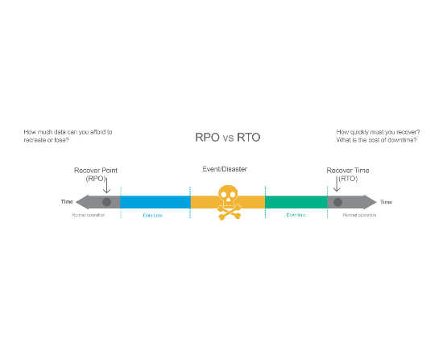


Backup and Restore
Create backups → store recovery points → restore after failure
Lowest-cost basic disaster recovery approach
Recovery is slower because infrastructure may need to be rebuilt
Suitable when longer recovery time is acceptable
Typical flow: Disaster → Restore backups → Rebuild service → Validate

Slide 45


Pilot Light
Pilot light is an AWS disaster recovery strategy that maintains a minimal, essential version of your infrastructure in a secondary region to balance cost efficiency with rapid recovery capabilities.
Keep a minimal version of the environment running
Core data and essential components are continuously or regularly replicated
Scale up the environment during a disaster
Faster recovery than backup and restore
Requires more planning and cost than basic backup

Slide 46



Warm Standby
Warm Standby is a disaster recovery strategy in AWS
Maintain a scaled-down but functional environment
Data is kept relatively current through replication
Scale resources up during recovery
Faster recovery than pilot light
Costs more because an environment is continuously running

Slide 47


Multi-Site / Active-Active
Run production workloads across multiple sites or Regions
Traffic can be served by more than one environment
Failure of one site can shift traffic to another
Provides very fast recovery and minimal downtime
Generally the most complex and expensive strategy

Slide 48
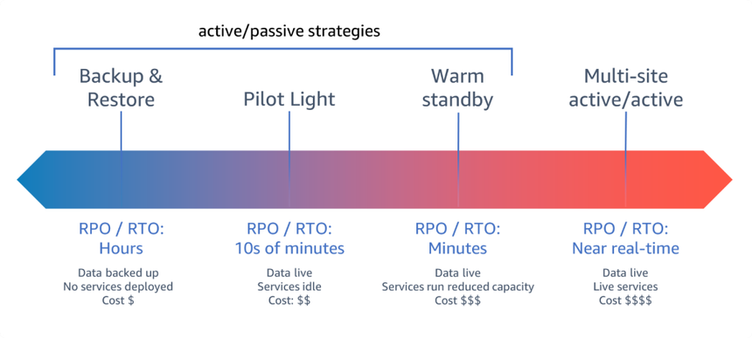
DR Strategy Comparison (RTO & Cost)

Slide 49

AWS Services Supporting DR
AWS Backup → centralized backup and recovery management
Amazon S3 → durable object storage and replication options
Amazon FSx → managed file systems for application storage
Amazon EC2 → compute recovery and standby environments
Amazon Route 53 → DNS-based traffic routing and failover
AWS CloudFormation → repeatable infrastructure deployment

Slide 50


Automation & Infrastructure as Code
Infrastructure as Code defines infrastructure in templates
CloudFormation can recreate environments consistently
Automation reduces manual recovery steps
Automated deployment can reduce RTO
Recovery procedures should be version-controlled and tested

Slide 51


Disaster Recovery Testing
Test backup restoration regularly
Validate that applications start correctly
Measure actual recovery time against the RTO
Measure recovered data against the RPO
Document failures and improve the DR plan

Slide 52

Complete Storage Protection Strategy
Primary storage → highly available architecture
Replication → protects against infrastructure or location failures
AWS Backup → creates managed recovery points
Cross-Region/Account → improve isolation
CloudWatch → monitors health and performance
CloudTrail → audits administrative activity
DR automation → restores services according to business targets

Slide 53
Key Takeaways
Choose the FSx service according to the workload
Durability protects data survival; availability protects access
Replication and backups provide different forms of protection
AWS Backup centralizes backup policies and recovery points
RPO defines acceptable data loss; RTO defines acceptable downtime
DR strategy should match business requirements, risk, and budget

